Slide 1
Credit Status Prediction
Akshita Khandelwal
Notes:
Business Problem (1-2 slides).
Dataset Description ( 1 slide).
System Design (flow chart) - ( 1 slide).
Data Preprocessing - ( 1 slide).
Algorithm Development ( 2 - 3 slides).
Results and Evaluation ( 2 -3 slides).
Conclusion and Lesson Learned ( 1-2 slides).
Limitations ( 1 slides).
References ( 1 slide).

Slide 2
Business Problem
In the United States, a credit score is used to measure creditworthiness of a person, which is the likelihood that a person will pay their bills
Credit scores can impact an individual’s meaningful participation in modern society. E.g. rental applications, employment, insurance etc.
We would like to shed more light on how an individual can improve their credit score or maintain a good credit score
We will attempt to identify the top predictors of an acceptable credit score
Also, we will look for factors that have the least impact on credit scores

Slide 3
Dataset
Dataset Source: Kaggle
Credit score classification | Kaggle
27 Total Features
Feature importance is done to drop unnecessary columns to reduce noise in our modelling
Covering a range of data types like integers, floats, strings, boolean and objects
Features looking at a person’s financial situation, payment habits, age, occupation and other factors
No. of observations → 100,000

Slide 4
Dataset
Initial Variables List
ID | Customer_ID | Month | Name | SSN | Occupation
Num_of_Loan | Annual_Income | Monthly_Inhand_Salary | Num_Bank_Accounts | Num_Credit_Card | Interest_Rate
Changed_Credit_Limit | Num_Credit_Inquiries | Type_of_Loan | Delay_from_due_date | Num_of_Delayed_Payment | Credit_History_Age
Outstanding_Debt | Credit_Utilization_Ratio | Credit_Mix | Payment_of_Min_Amount | Total_EMI_per_month | Amount_invested_monthly
Payment_Behaviour | Credit_Score | Age
Notes:
The initial variables list captures important information about a customer's financial situation, payment habits, credit history, and personal details. These variables can be used to build a model that predicts the likelihood of a customer defaulting on a loan or making timely payments

Slide 5
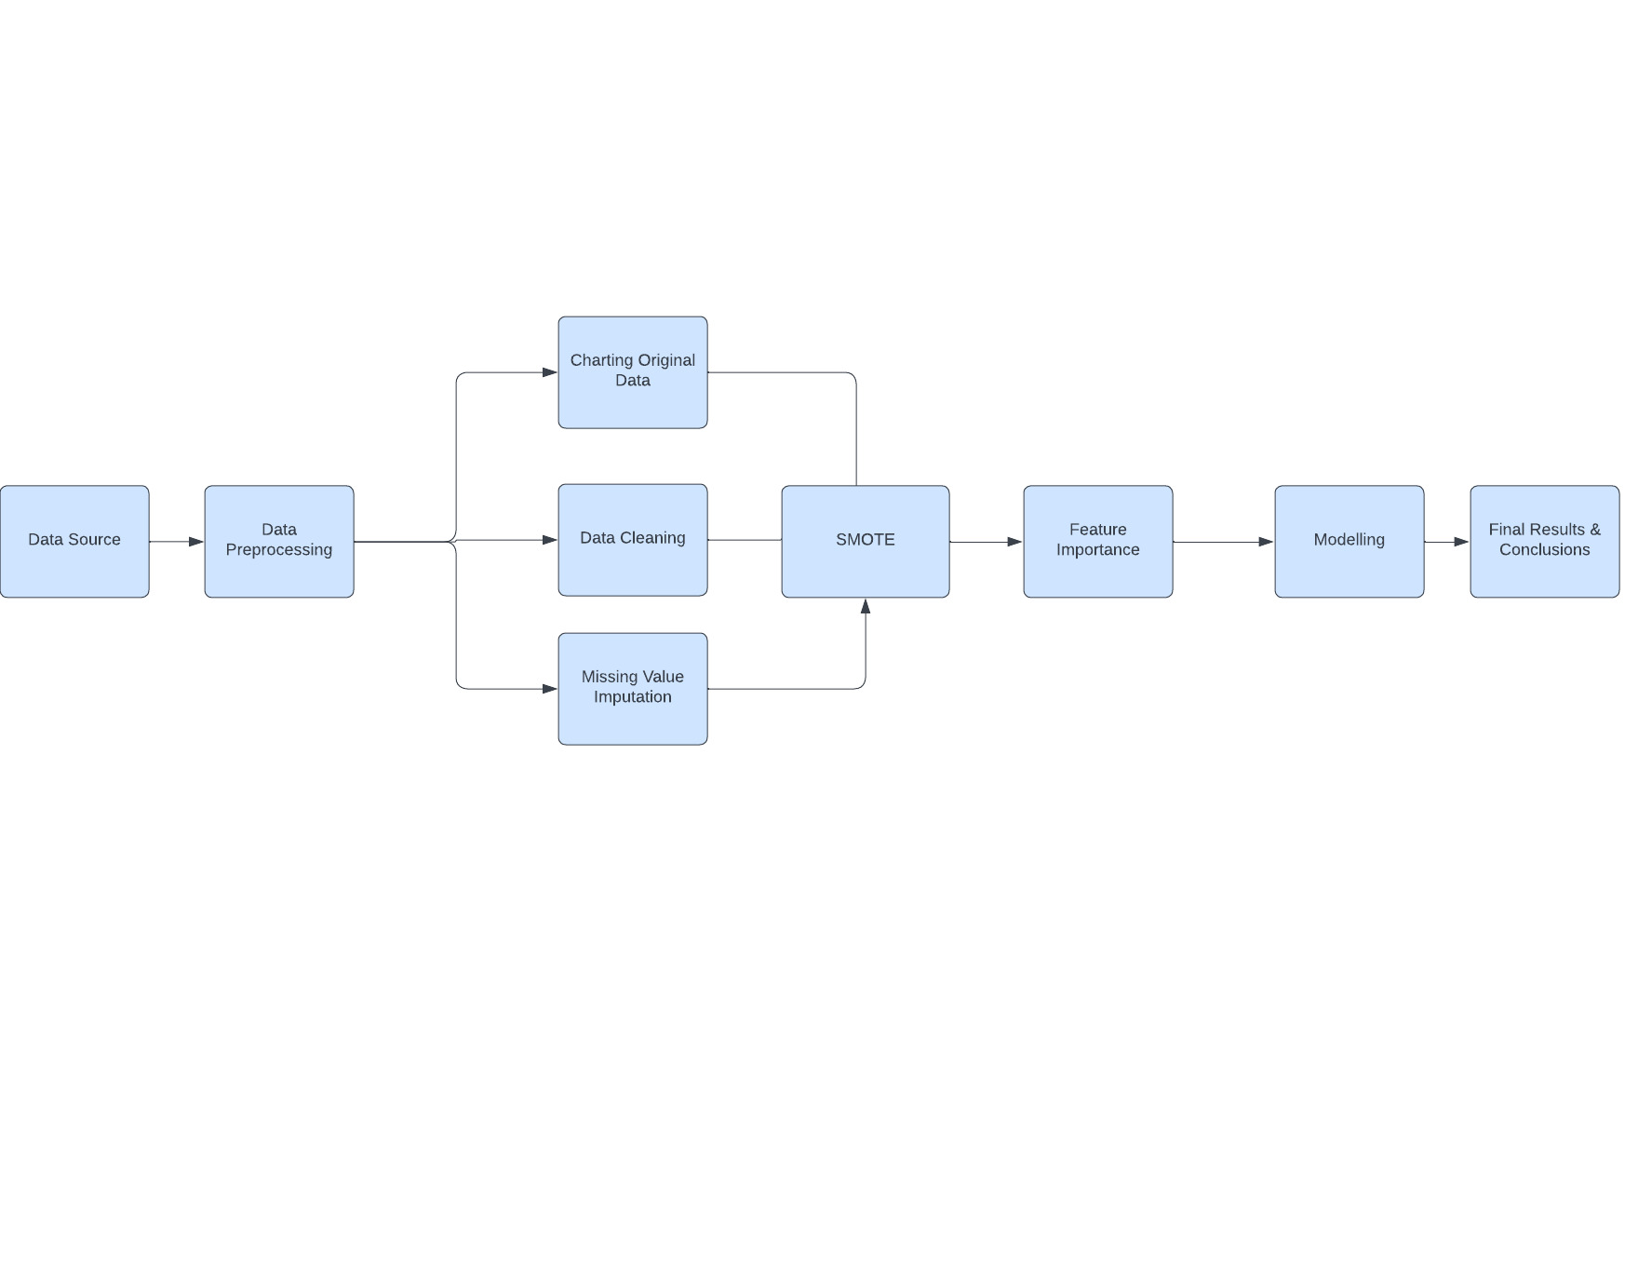
System Design

Slide 6
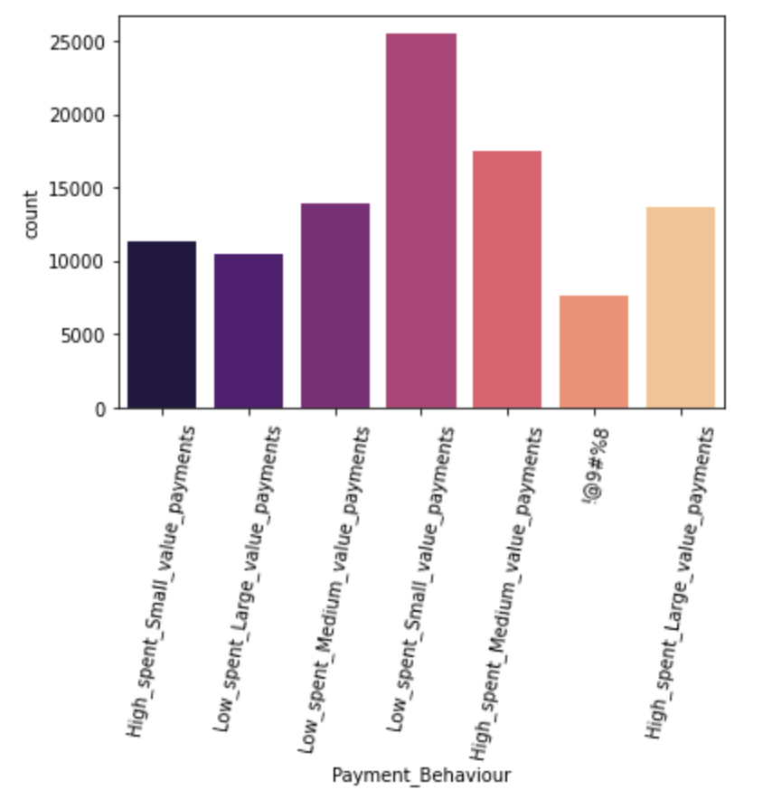
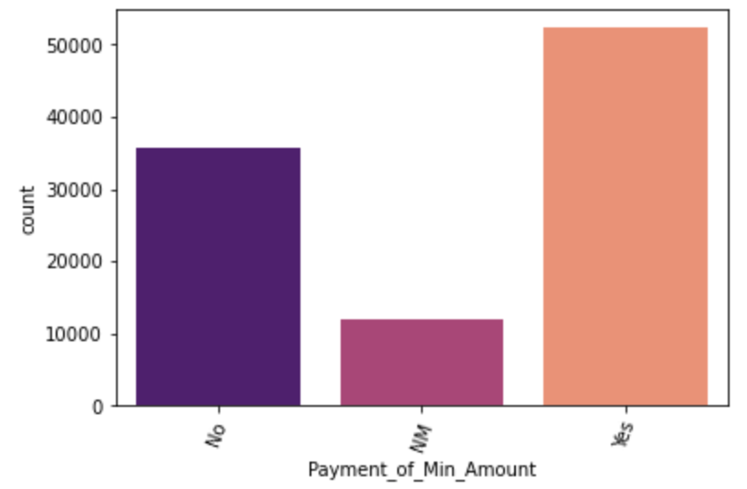
Data Preprocessing

Slide 7
Data Preprocessing
Messy data with missing values, irregular values, outliers and numerical columns with string data
After cleaning the data, we assigned the correct data type to each column
We filled all the missing numerical values and outliers outside a certain range with median values for each column
All missing categorical values were replaced by the mode of the respective columns
Our target variable Credit_Score came as a categorical variable with 3 different values: Good, Standard and Poor. We turned it into a binary variable

Slide 8
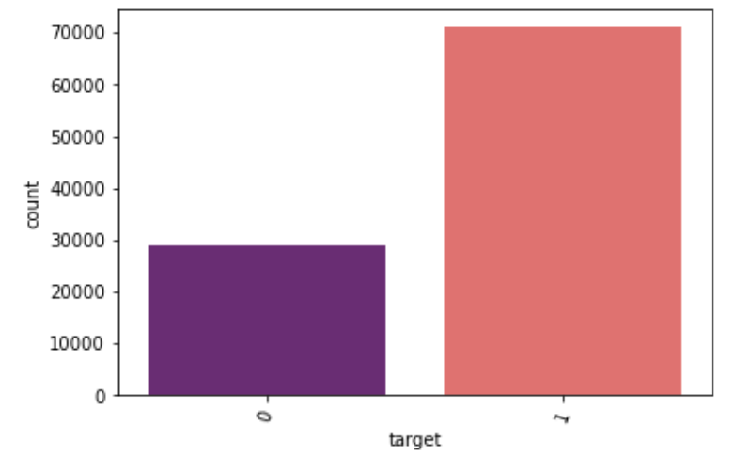
Algorithm Development
Numerical variables were standardized and dummy variables were created to fit into our models
We charted the distribution of our target variable, the remapped credit score, and found the data to be quite unbalanced
SMOTE was applied to rebalance the dataset to avoid any chance of the rare event problem affecting our results

Slide 9
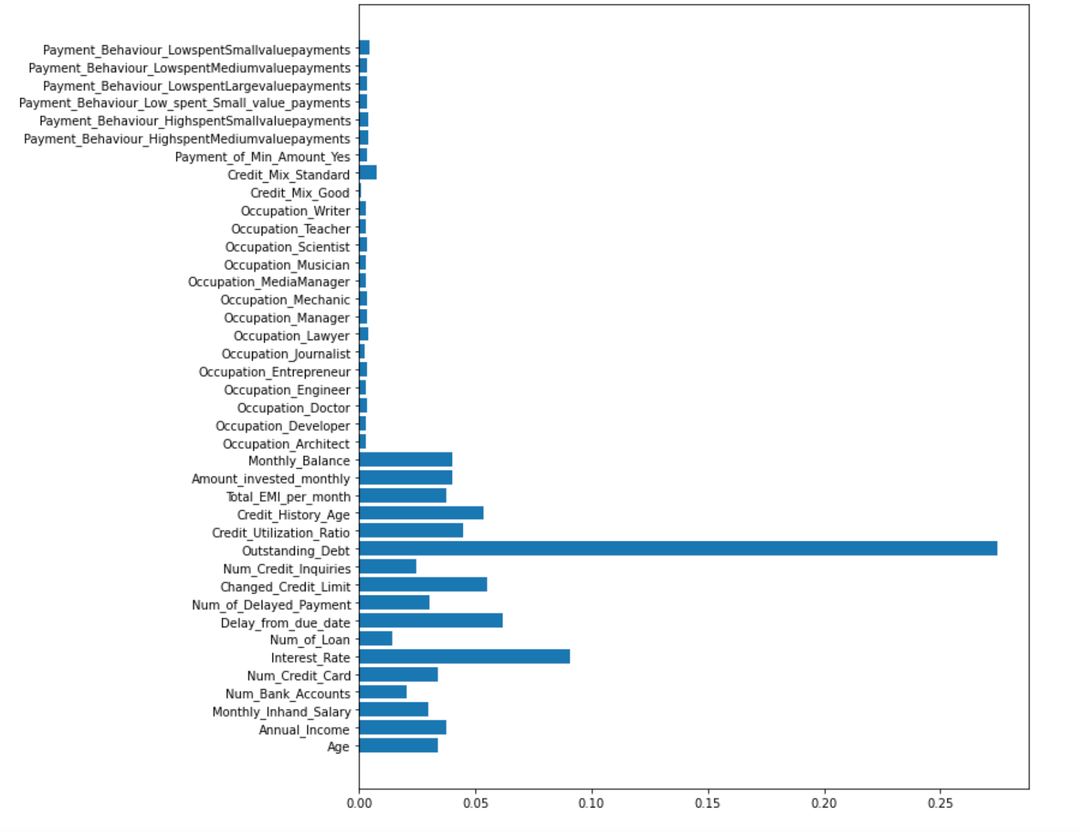
Algorithm Development
To reduce noise and to maintain a parsimonious structure for our models, we ran a feature importance model to see if we could reduce the no. of features on our models
We found Occupation, Payment Behaviour, no. of loans, no. of credit cards, no. of bank accounts to be less relevant according to our analysis, so they were all dropped from our final dataset

Slide 10
Algorithm Development
Final Variables List
Interest_Rate | Annual_Income | Monthly_Inhand_Salary | Amount_invested_monthly | Monthly_Balance
Changed_Credit_Limit | Num_Credit_Inquiries | Type_of_Loan | Delay_from_due_date | Num_of_Delayed_Payment
Credit_History_Age | Payment_of_Min_Amount | Credit_Mix | Outstanding_Debt | Credit_Utilization_Ratio
Total_EMI_per_month | Credit_Score

Slide 11
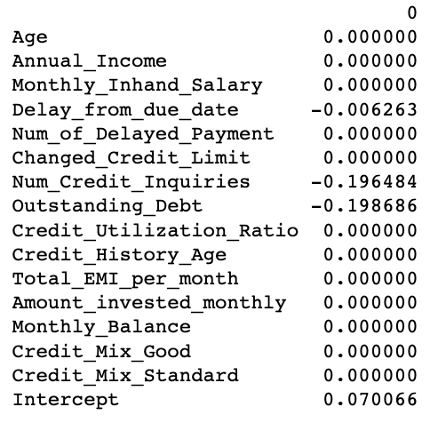
Results and Evaluation - Logistic Regression
We used a pre specified penalty system with our logistic regression model to find the most and least important determinants of a credit score
We adjusted the penalty to find which predictors dropped off and stayed on
The last predictor to drop off was outstanding debt which makes it the most important predictor of an individual’s credit score

Slide 12
Results and Evaluation - k nearest neighbor
The knn model was the faster of the 2 models we chose to utilize for our research
Performance was fairly impressive especially in classifying people with good/standard credit scores
May be better to use in time sensitive applications or when working with limited computing capabilities
Credit Score Type | Precision | Recall | F1-score
Poor | 0.60 | 0.80 | 0.68
Standard/Good | 0.91 | 0.78 | 0.84

Slide 13
Results and Evaluation - Random Forest
The random forest model we built with our final dataset was the better performing out of the 2
It beat out the knn model in just about every measure on the classification report
This model could potentially be used in real life application in financial institutions to act as an automated classifier for loan applicants and other bank customers
Credit Score Type | Precision | Recall | F1-score
Poor | 0.75 | 0.80 | 0.78
Standard/Good | 0.92 | 0.89 | 0.90

Slide 14
Conclusions and Lessons Learned
Credit score appears to be most influenced by how a person manages his/her debt in terms of size, punctuality when it comes to meeting payment deadlines and how many additional credit cards a person requests
Factors like how much a person uses a credit card, monthly income and monthly balance ended up not being as important as one would think
We were also able to build models with fairly impressive accuracy that could be applied in real life use cases

Slide 15
Limitations
Restriction in analysis due to limits in CPU capacity since processing of big data can take up significant CPU load
For future research, it would be helpful to build out this model on a periodic basis with changing economic conditions as the importance of a certain feature may increase and decrease over time

Slide 16
References
Dataset: https://www.kaggle.com/datasets/parisrohan/credit-score-classification?resource=download
Feature Importance: https://towardsdatascience.com/understanding-feature-importance-and-how-to-implement-it-in-python-ff0287b20285

